Slide 1
Entity-Relationship modeling
Transparencies
© Pearson Education Limited 1995, 2005

Slide 2
Objectives
How to use Entity–Relationship (ER) modeling in database design.
Basic concepts associated with ER model.
Diagrammatic technique for displaying ER model using Unified Modeling Language (UML).
How to identify and resolve problems with ER models called connection traps.
How to build an ER model from a requirements specification.
© Pearson Education Limited 1995, 2005

Slide 3
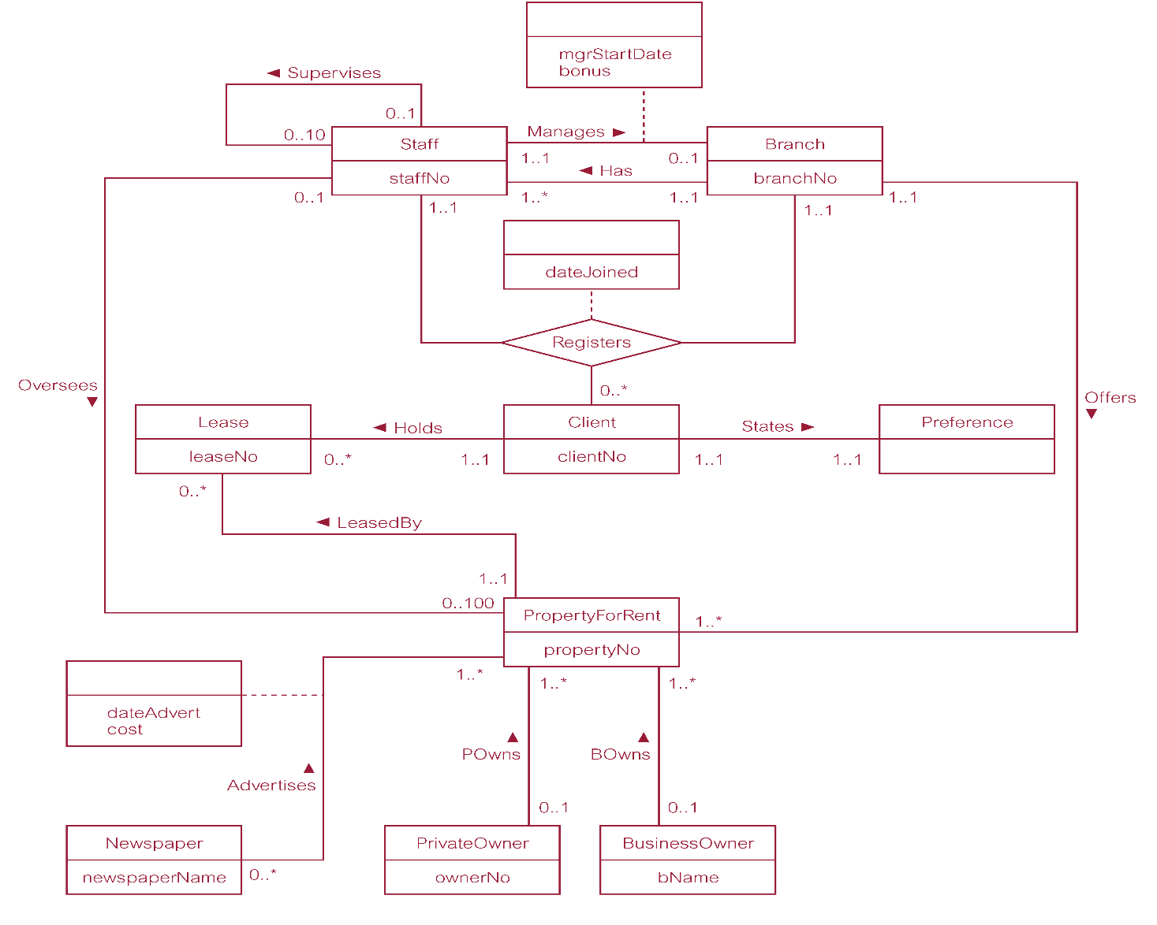
ER diagram of Branch user views of DreamHome
© Pearson Education Limited 1995, 2005

Slide 4
Concepts of the ER Model
Entity types
Relationship types
Attributes
© Pearson Education Limited 1995, 2005

Slide 5
Entity Type
Entity type
  Group of objects with same properties, identified by enterprise as having an independent existence.
Entity occurrence
  Uniquely identifiable object of an entity type.
© Pearson Education Limited 1995, 2005

Slide 6
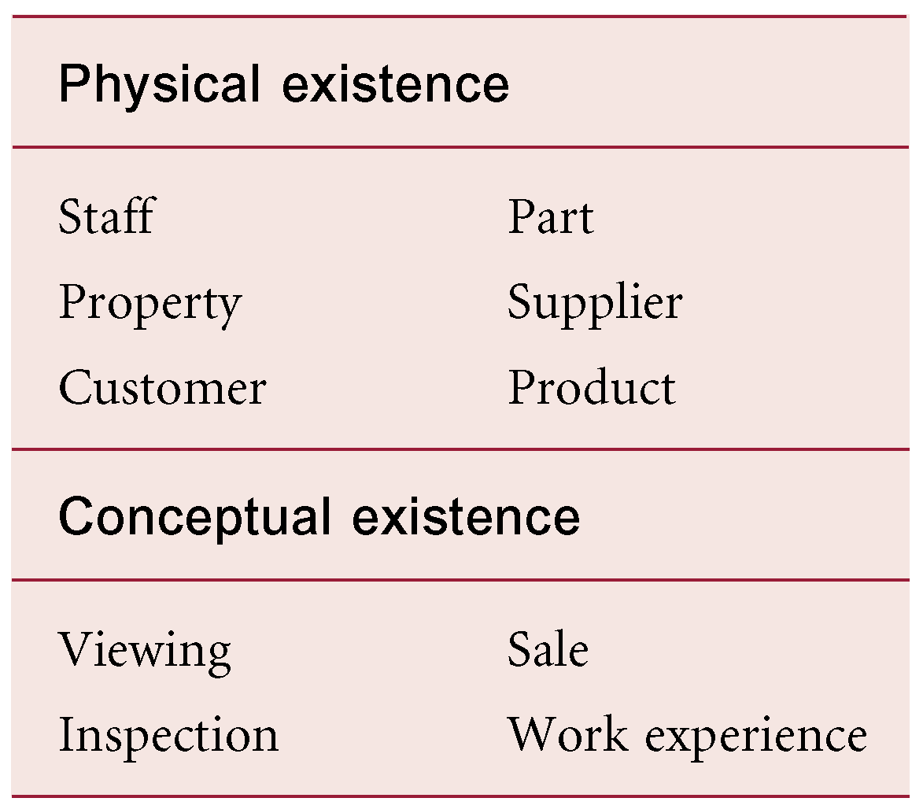
Examples of Entity Types
© Pearson Education Limited 1995, 2005

Slide 7
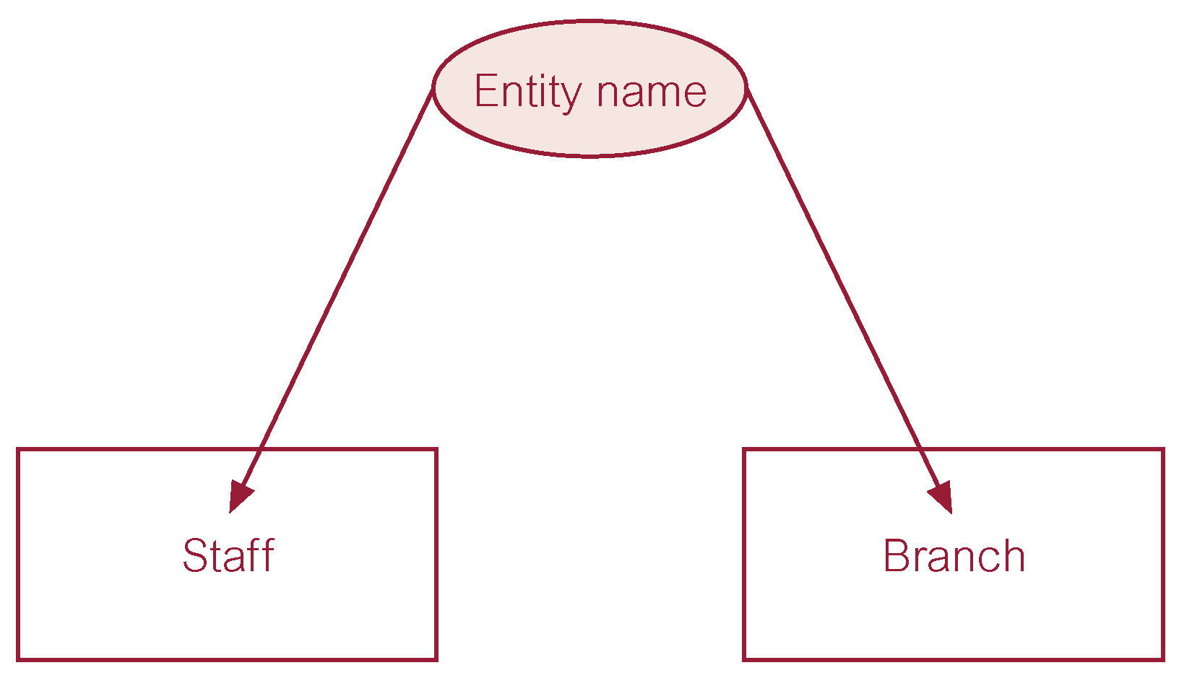
ER diagram of Staff and Branch entity types
© Pearson Education Limited 1995, 2005

Slide 8
Relationship Types
Relationship type
  Set of meaningful associations among entity types.
Relationship occurrence
  Uniquely identifiable association, which includes one occurrence from each participating entity type.
© Pearson Education Limited 1995, 2005

Slide 9
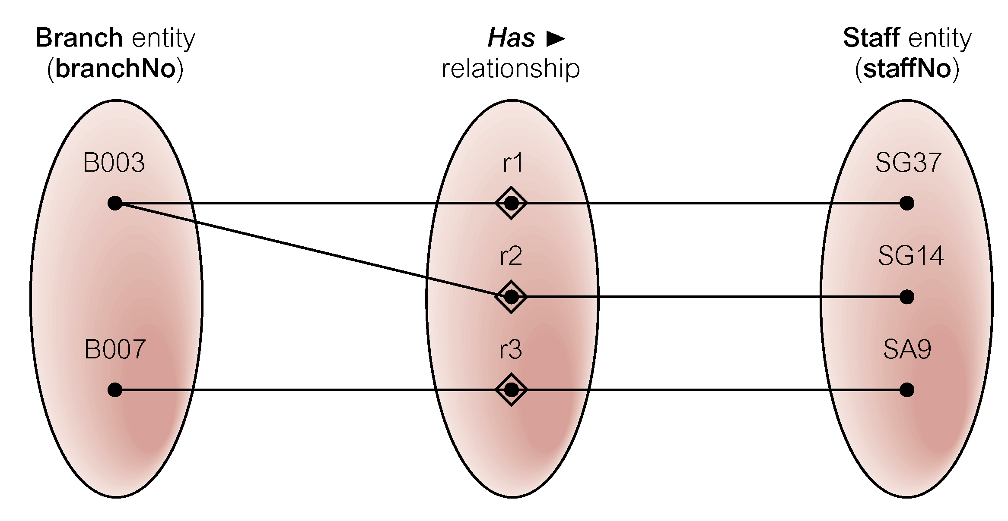
Semantic net of Has relationship type
© Pearson Education Limited 1995, 2005

Slide 10
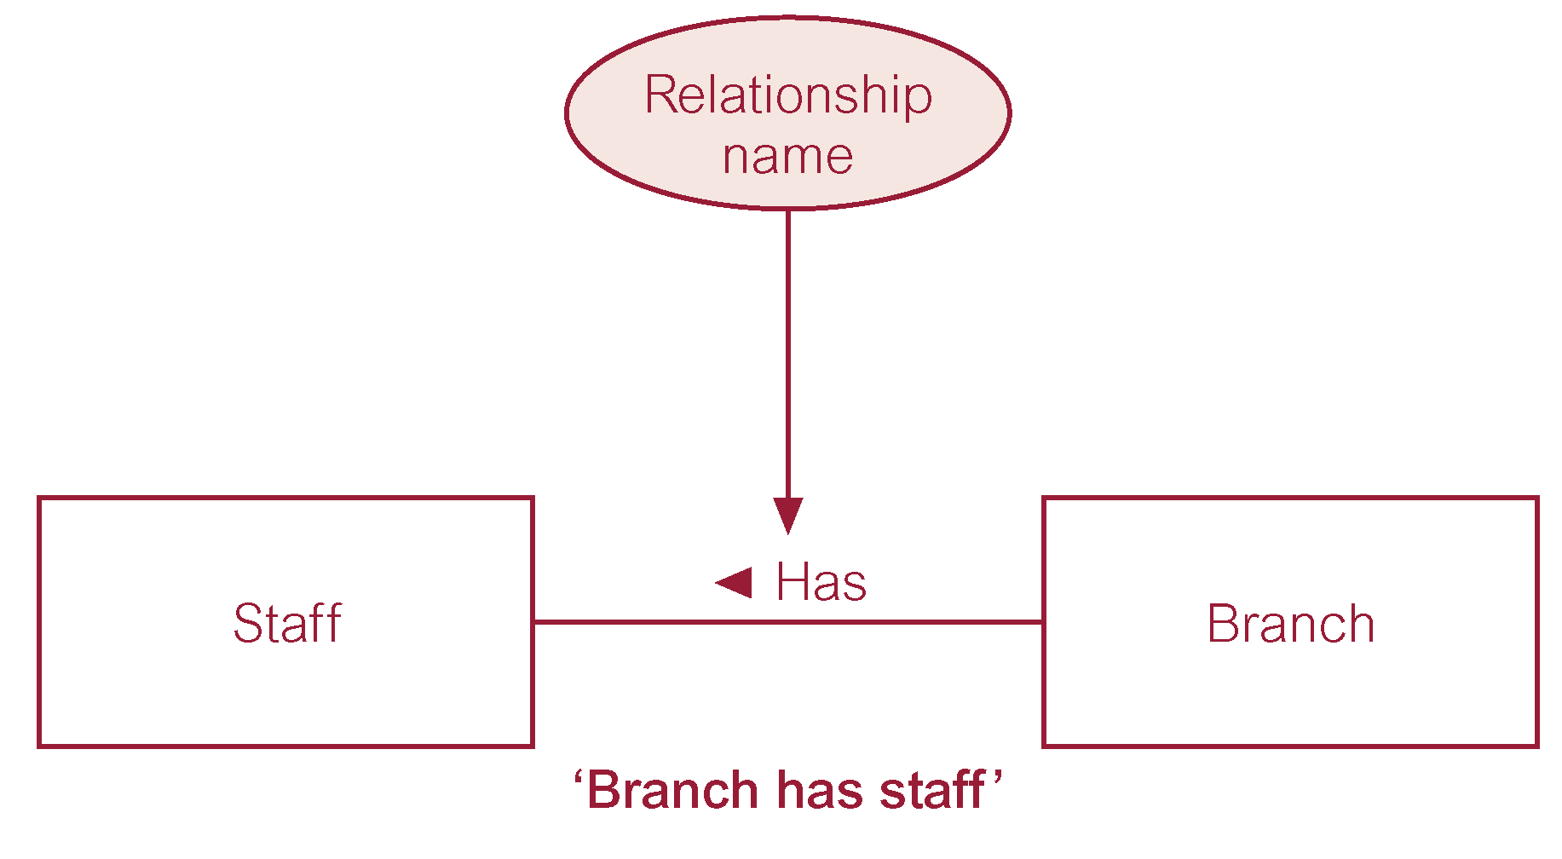
ER diagram of Branch Has Staff relationship
© Pearson Education Limited 1995, 2005

Slide 11
Relationship Types
Degree of a Relationship
  Number of participating entities in relationship.
Relationship of degree :
  two is binary
  three is ternary
  four is quaternary.
© Pearson Education Limited 1995, 2005

Slide 12

Binary relationship called POwns
© Pearson Education Limited 1995, 2005

Slide 13
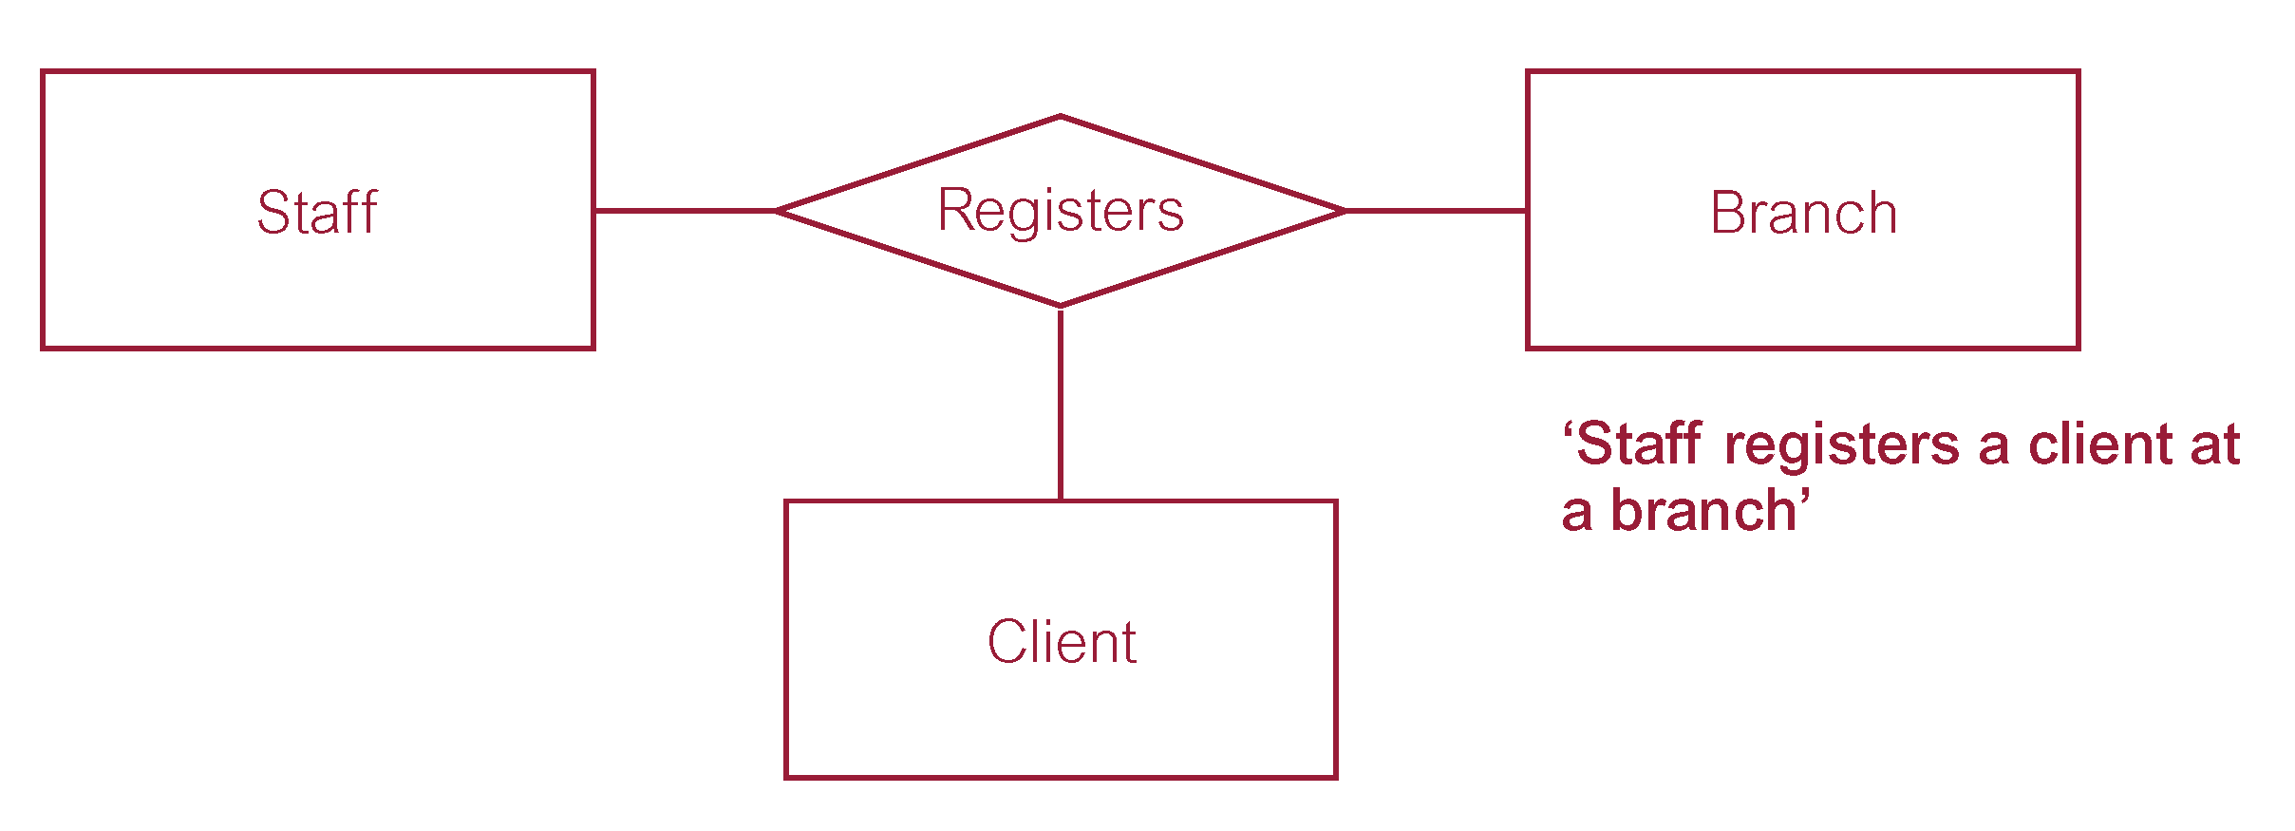
Ternary relationship called Registers
© Pearson Education Limited 1995, 2005

Slide 14
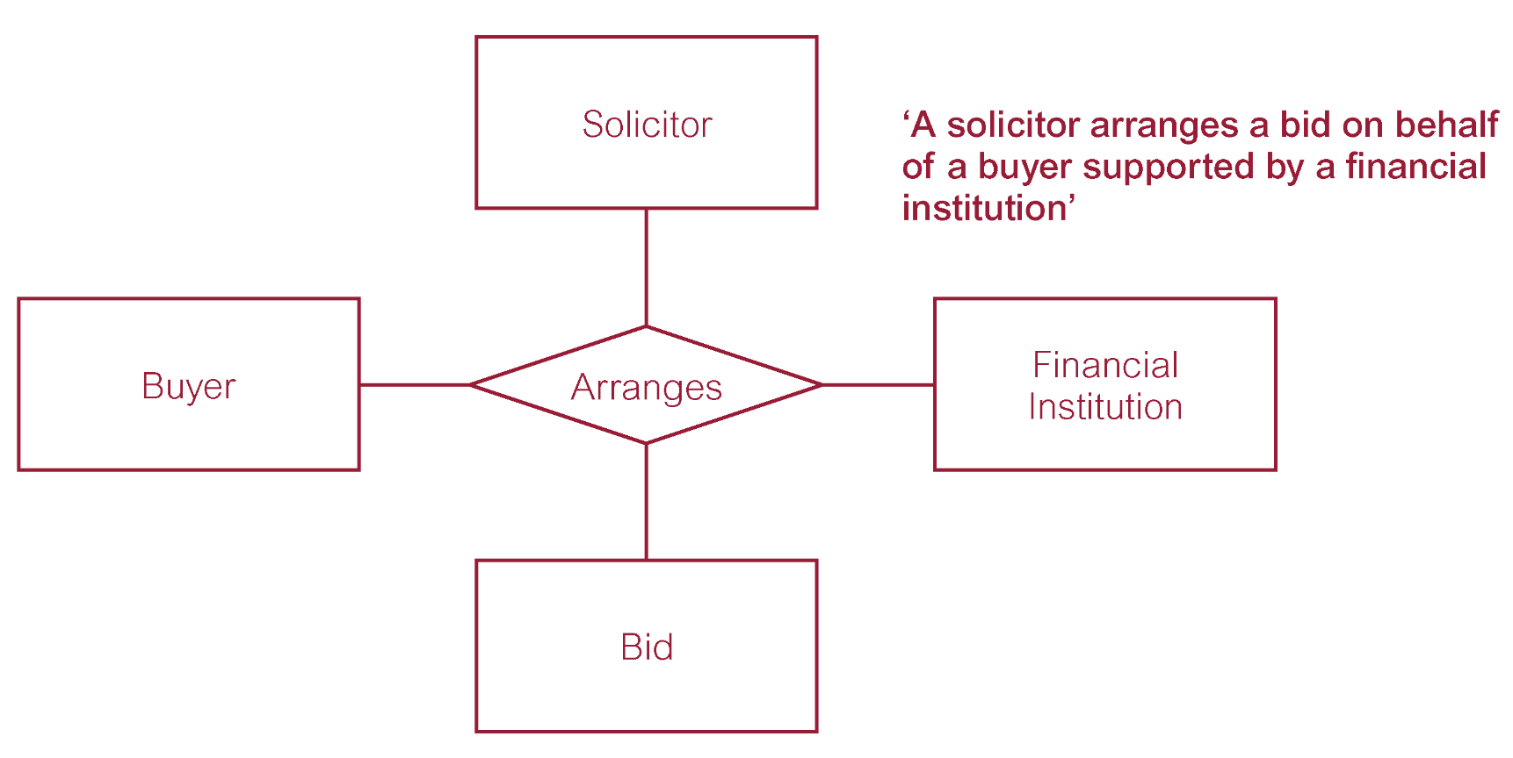
Quaternary relationship called Arranges
© Pearson Education Limited 1995, 2005

Slide 15
Relationship Types
Recursive Relationship
  Relationship type where same entity type participates more than once in different roles.
Relationships may be given role names to indicate purpose that each participating entity type plays in a relationship.
© Pearson Education Limited 1995, 2005

Slide 16
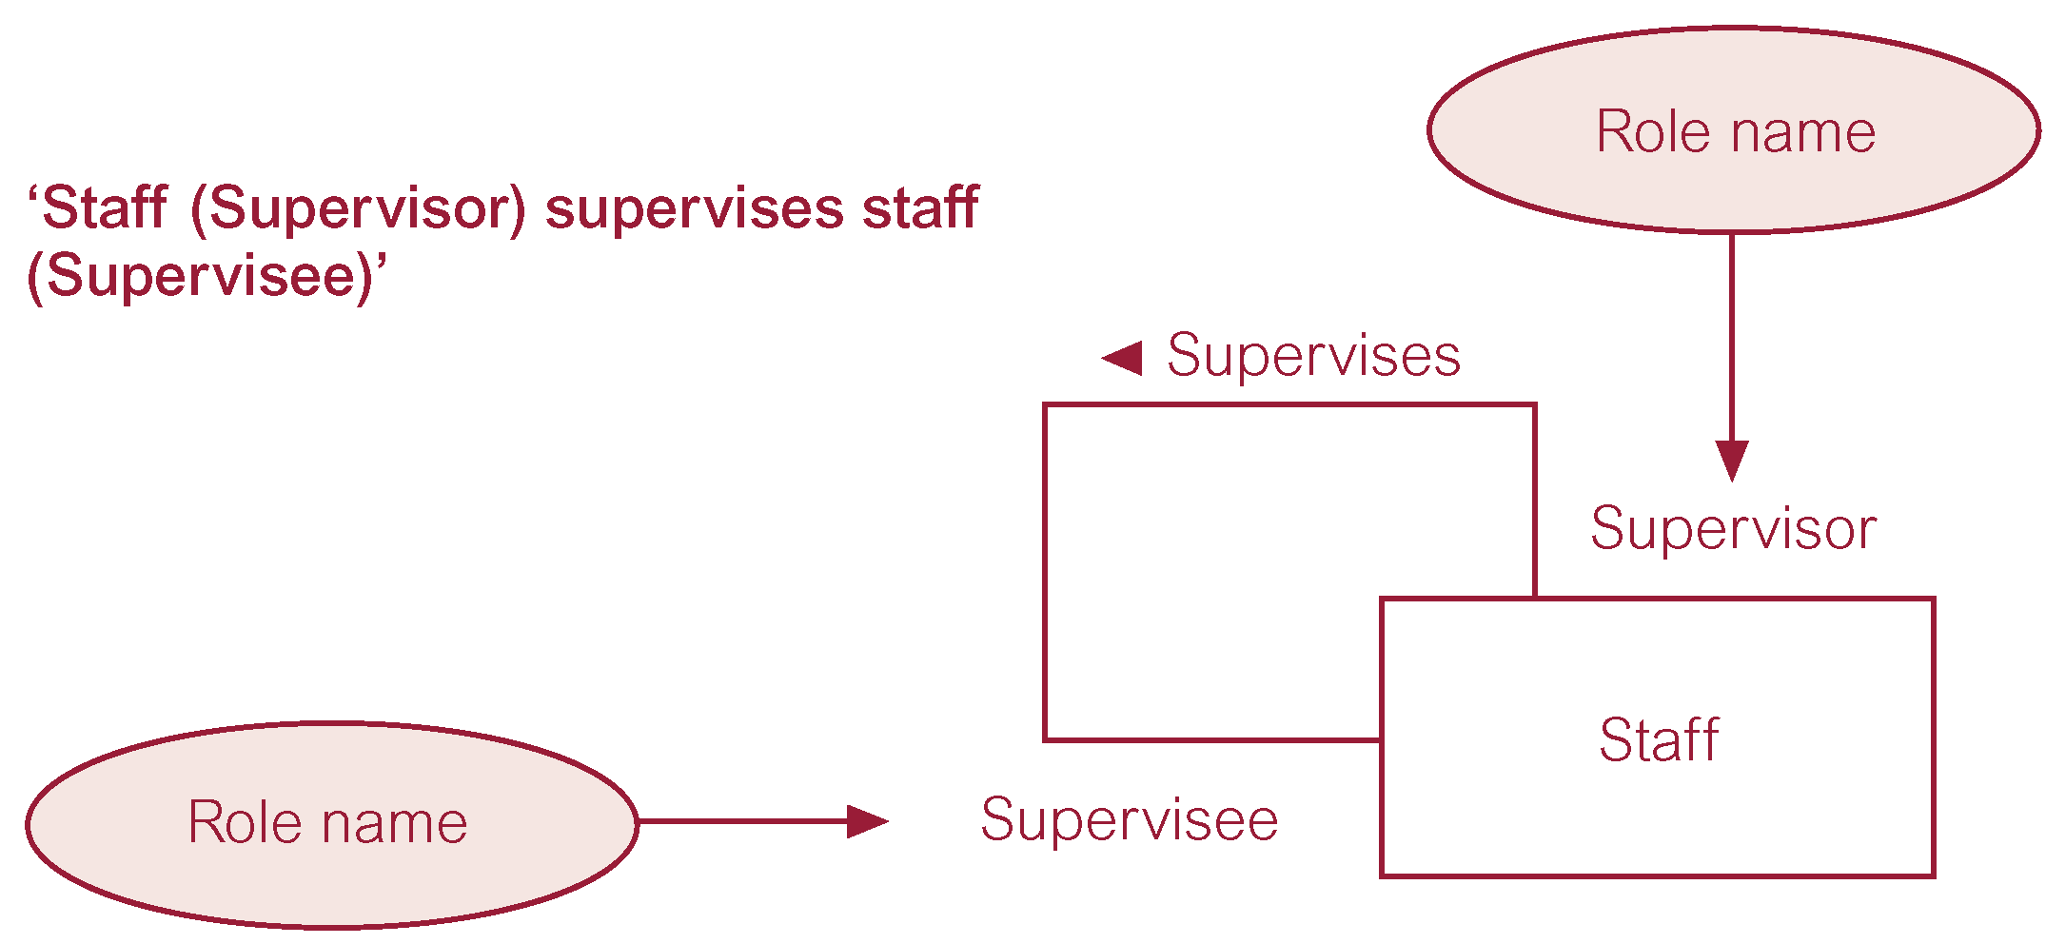
Recursive relationship called Supervises with role names
© Pearson Education Limited 1995, 2005

Slide 17
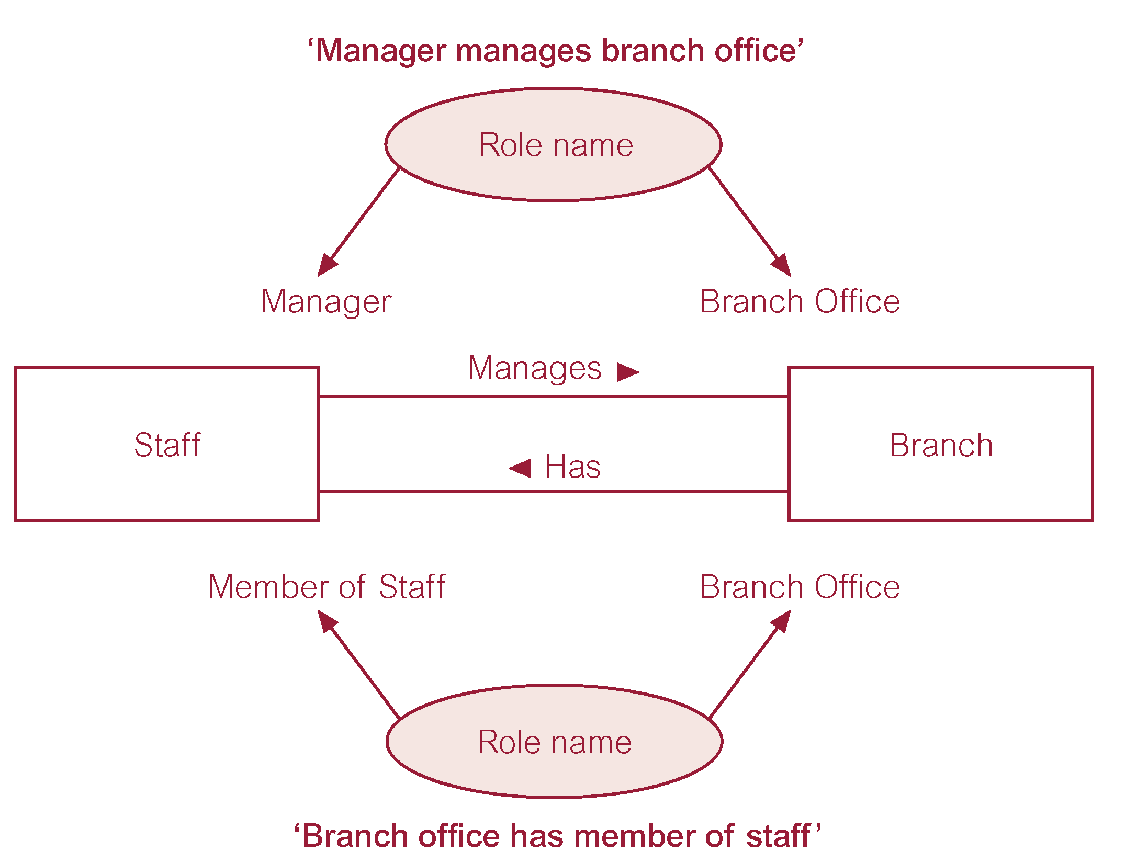
Entities associated through two distinct relationships with role names
© Pearson Education Limited 1995, 2005

Slide 18
Attributes
Attribute
  Property of an entity or a relationship type.
Attribute Domain
  Set of allowable values for one or more attributes.
© Pearson Education Limited 1995, 2005

Slide 19
Attributes
Simple Attribute
  Attribute composed of a single component with an independent existence.
Composite Attribute
  Attribute composed of multiple components, each with an independent existence.
© Pearson Education Limited 1995, 2005

Slide 20
Attributes
Single-valued Attribute
  Attribute that holds a single value for each occurrence of an entity type.
Multi-valued Attribute
  Attribute that holds multiple values for each occurrence of an entity type.
© Pearson Education Limited 1995, 2005

Slide 21
Attributes
Derived Attribute
  Attribute that represents a value that is derivable from value of a related attribute, or set of attributes, not necessarily in the same entity type.
© Pearson Education Limited 1995, 2005

Slide 22
Keys
Candidate Key
  Minimal set of attributes that uniquely identifies each occurrence of an entity type.
Primary Key
  Candidate key selected to uniquely identify each occurrence of an entity type.
Composite Key
  A candidate key that consists of two or more attributes.
© Pearson Education Limited 1995, 2005

Slide 23
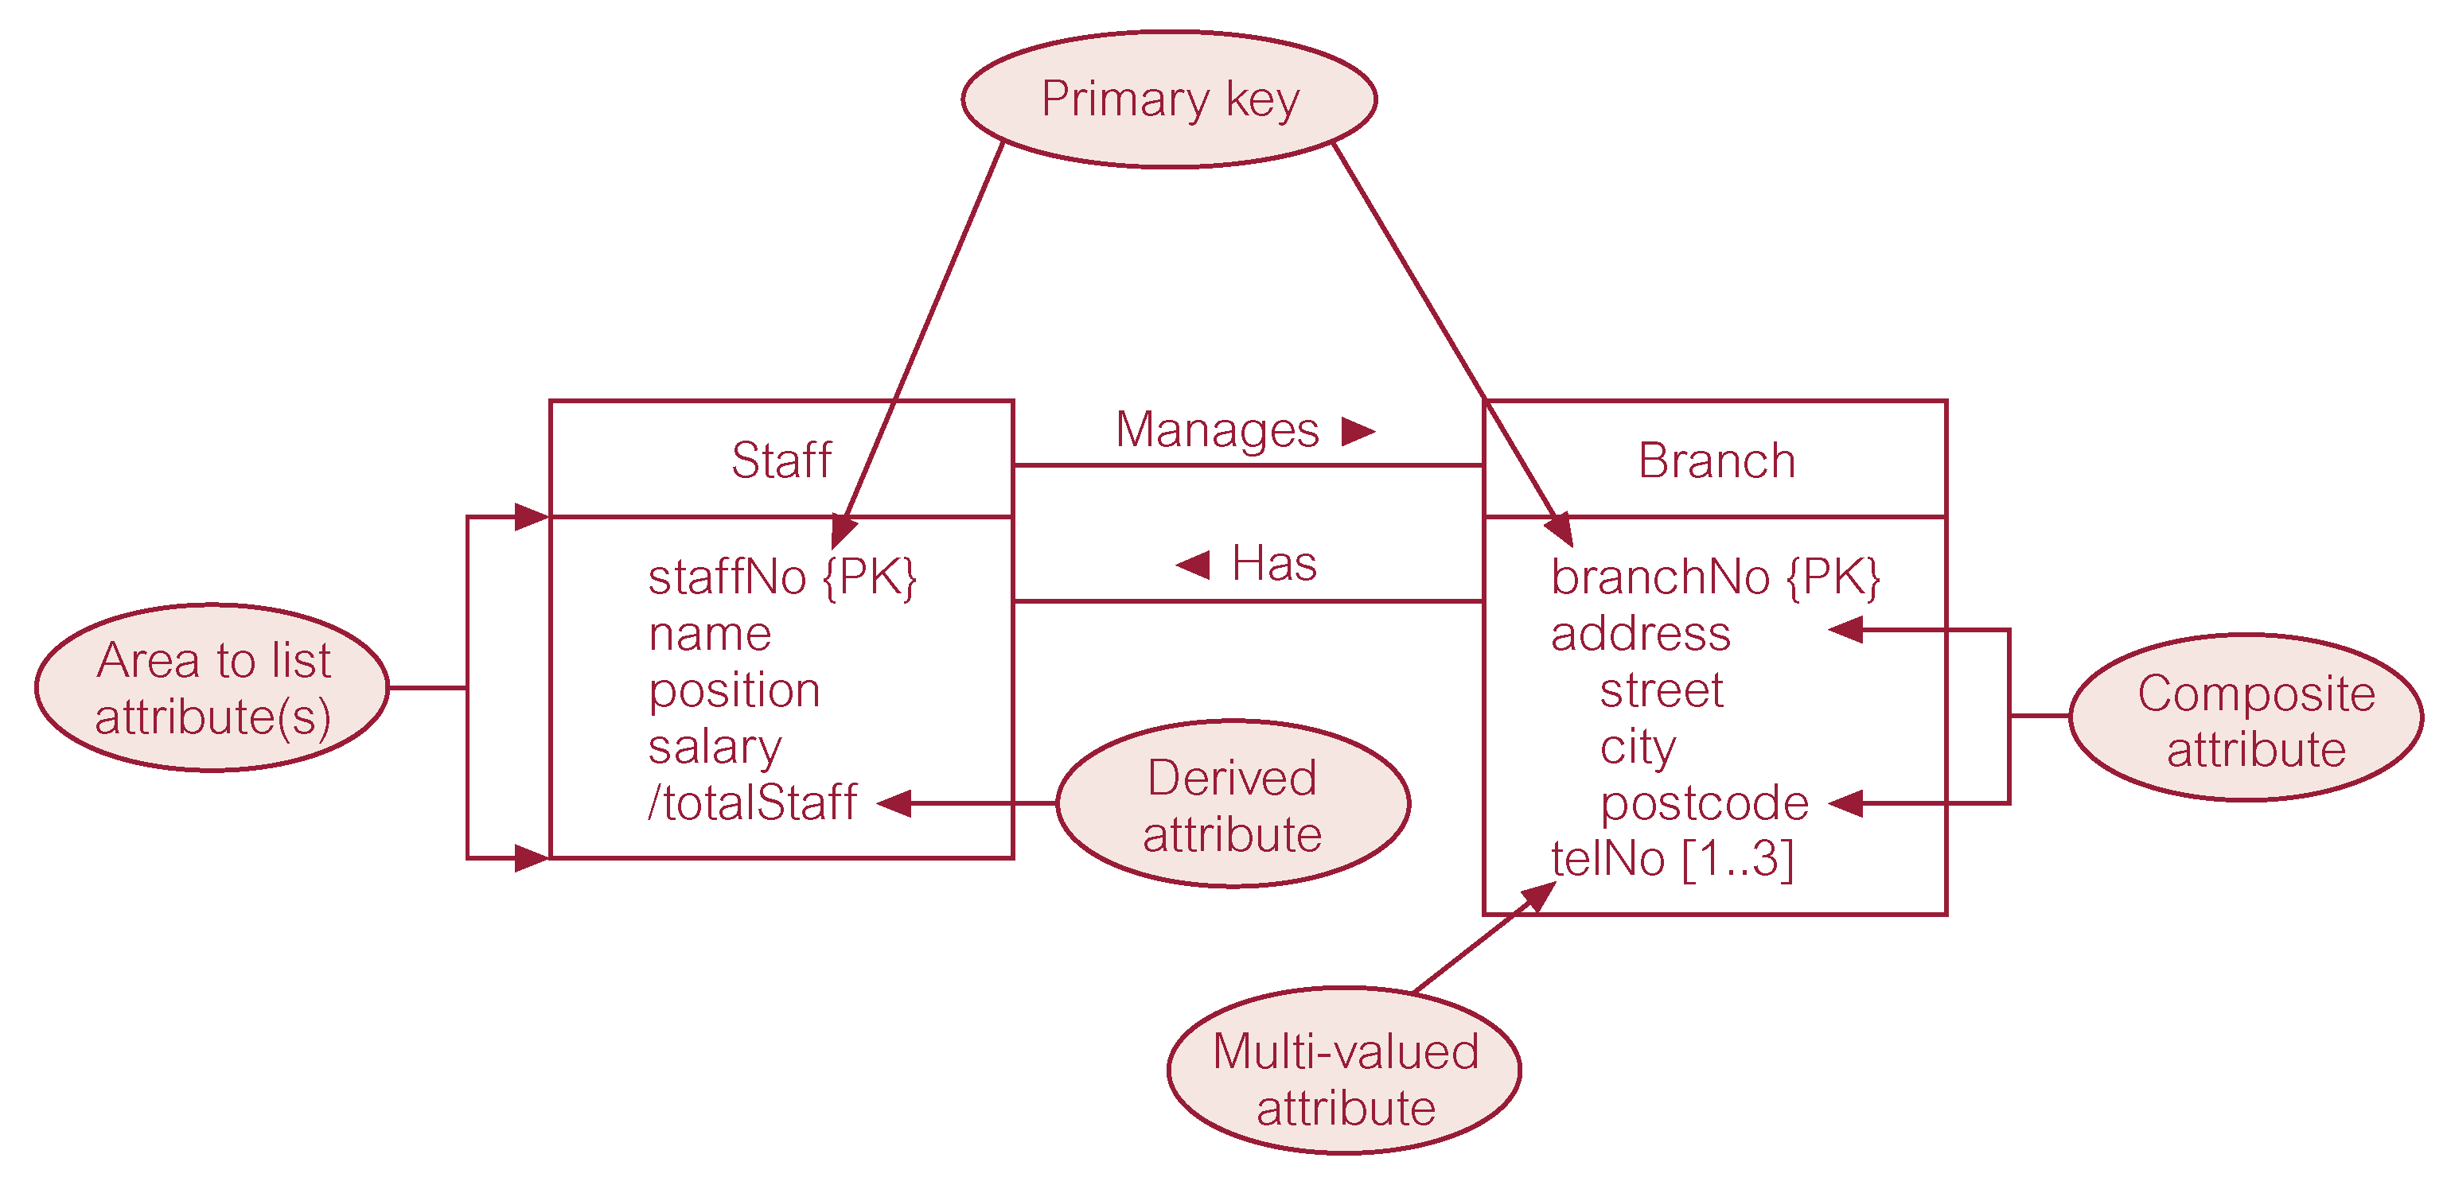
ER diagram of Staff and Branch entities and their attributes
Apt#, Building, Street, Sector/Muhalla, City, Country
© Pearson Education Limited 1995, 2005

Slide 24
Entity Type
Strong Entity Type
  Entity type that is not existence-dependent on some other entity type.
Weak Entity Type
  Entity type that is existence-dependent on some other entity type.
© Pearson Education Limited 1995, 2005

Slide 25
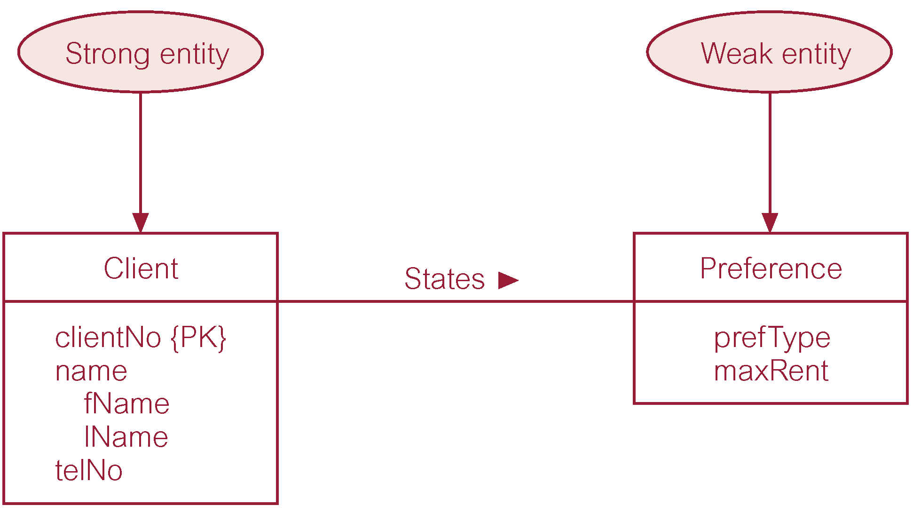
Strong entity type called Client and weak entity type called Preference
© Pearson Education Limited 1995, 2005

Slide 26
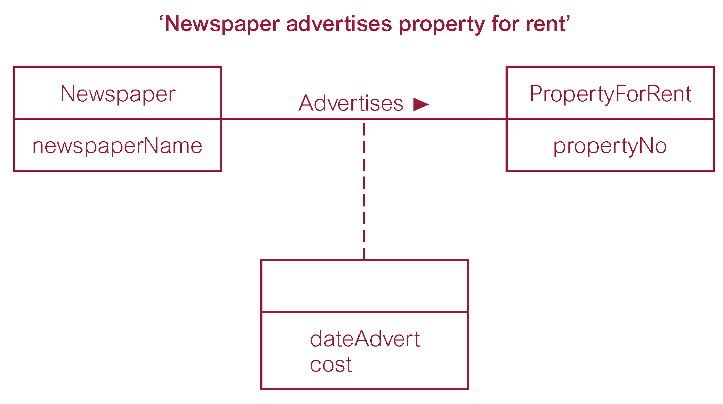
Relationship called Advertises with attributes
© Pearson Education Limited 1995, 2005

Slide 27
Structural Constraints
Main type of constraint on relationships is called multiplicity.
Multiplicity - number (or range) of possible occurrences of an entity type that may relate to a single occurrence of an associated entity type through a particular relationship.
Represents policies (called business rules) established by user or company.
© Pearson Education Limited 1995, 2005

Slide 28
Structural Constraints
The most common degree for relationships is binary.
Binary relationships are generally referred to as being:
  one-to-one (1:1)
  one-to-many (1:*)
  many-to-many (*:*)
© Pearson Education Limited 1995, 2005

Slide 29
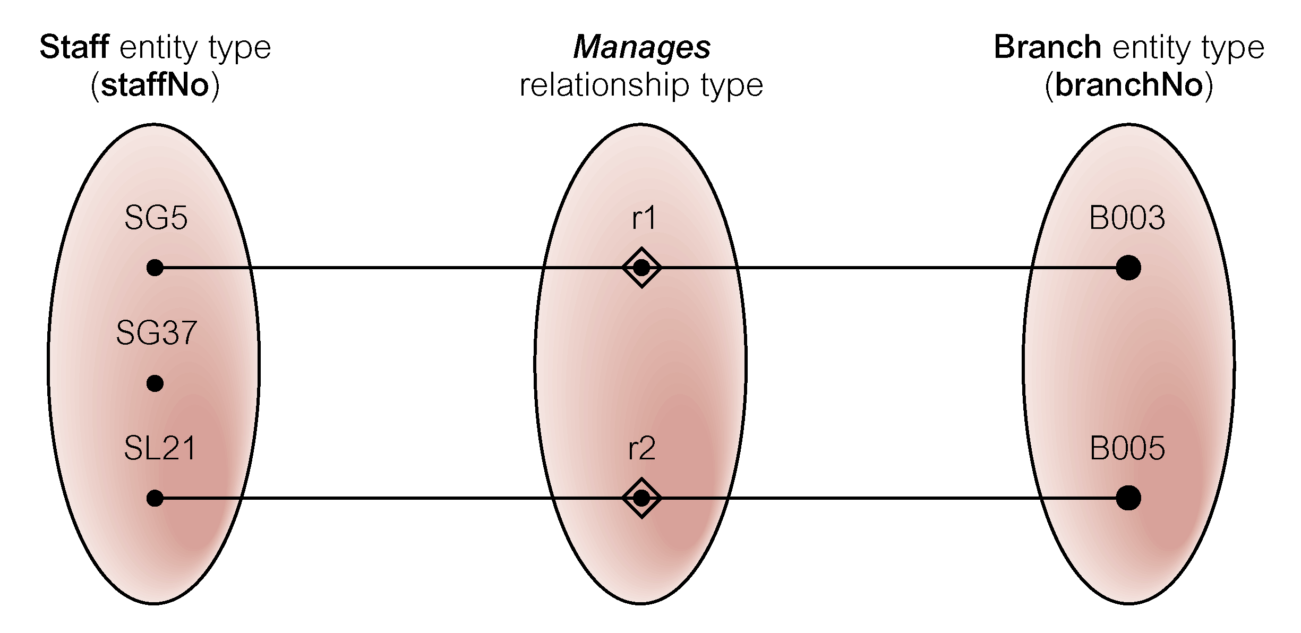
Semantic net of Staff Manages Branch relationship type
© Pearson Education Limited 1995, 2005

Slide 30
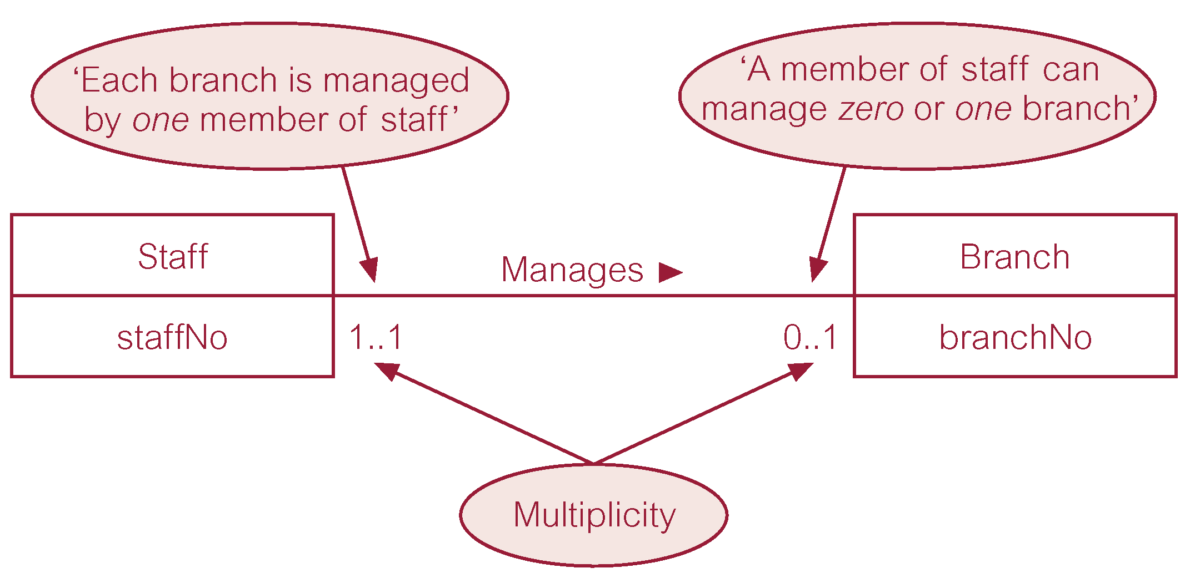
Multiplicity of Staff Manages Branch (1:1) relationship
© Pearson Education Limited 1995, 2005

Slide 31
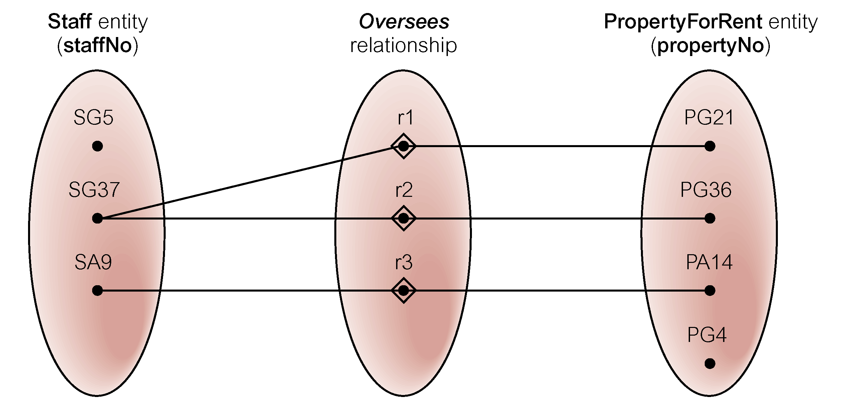
Semantic net of Staff Oversees PropertyForRent relationship type
© Pearson Education Limited 1995, 2005

Slide 32
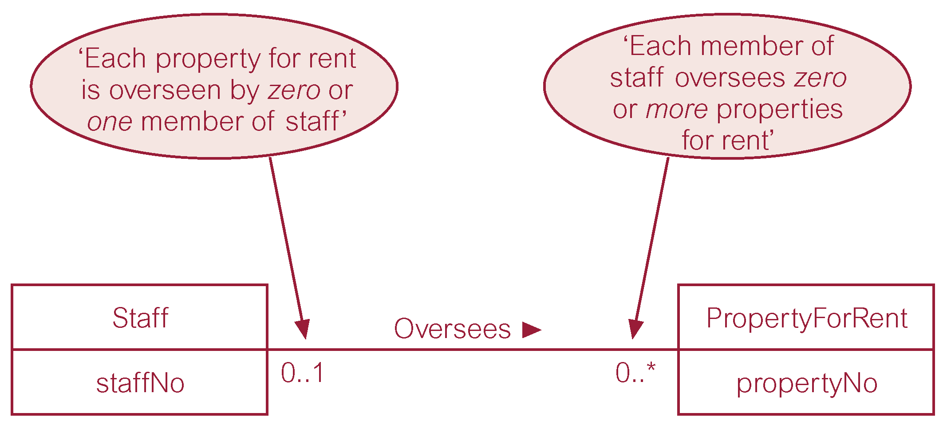
Multiplicity of Staff Oversees PropertyForRent (1:*) relationship type
© Pearson Education Limited 1995, 2005

Slide 33
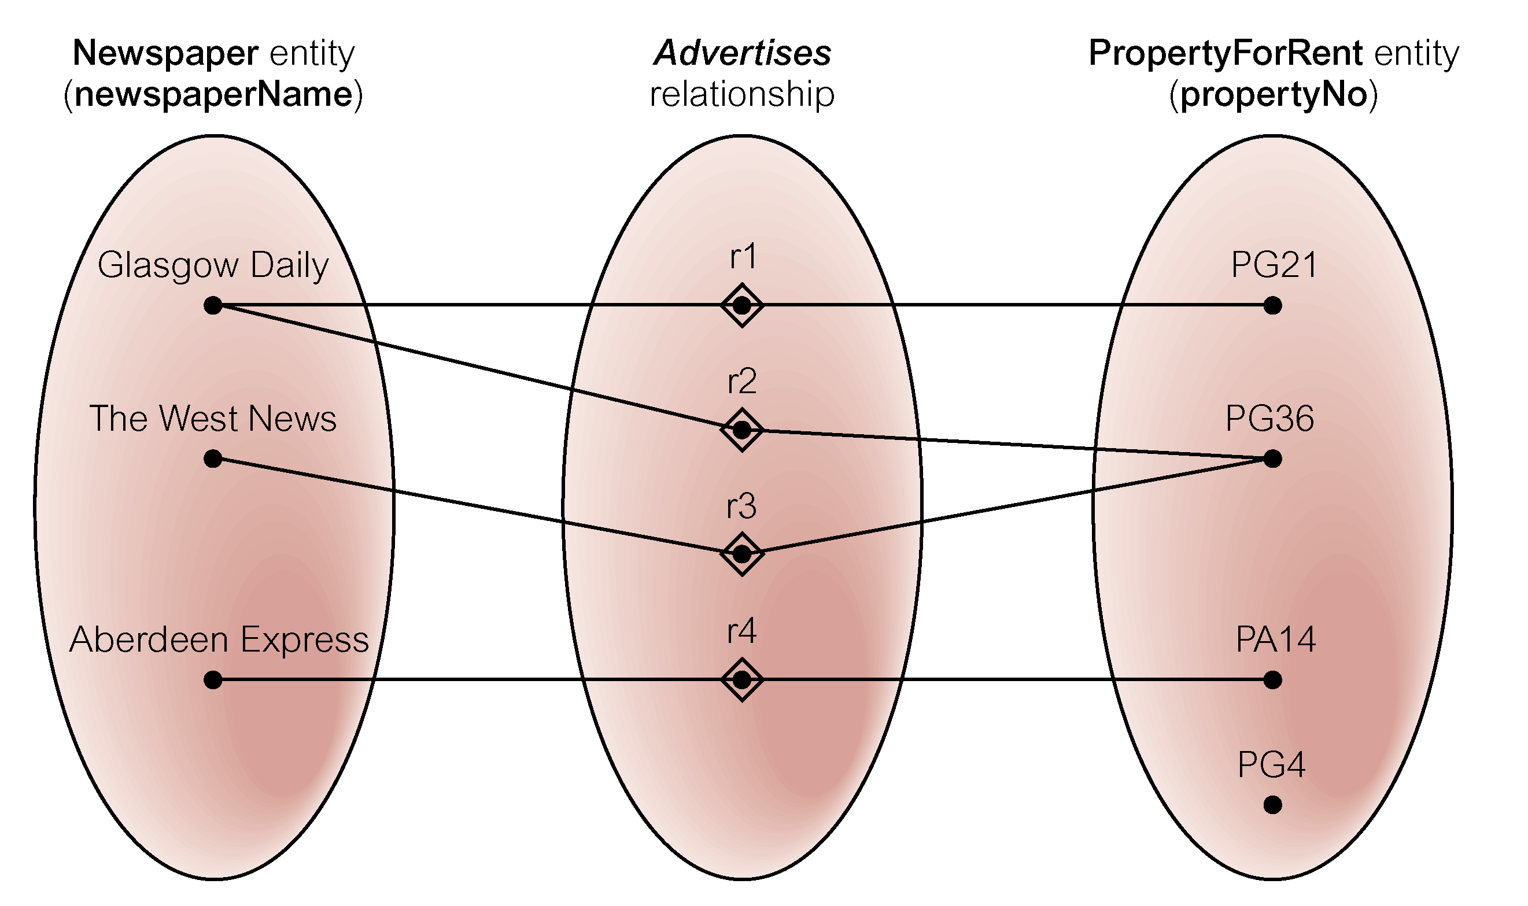
Semantic net of Newspaper Advertises PropertyForRent relationship type
© Pearson Education Limited 1995, 2005

Slide 34
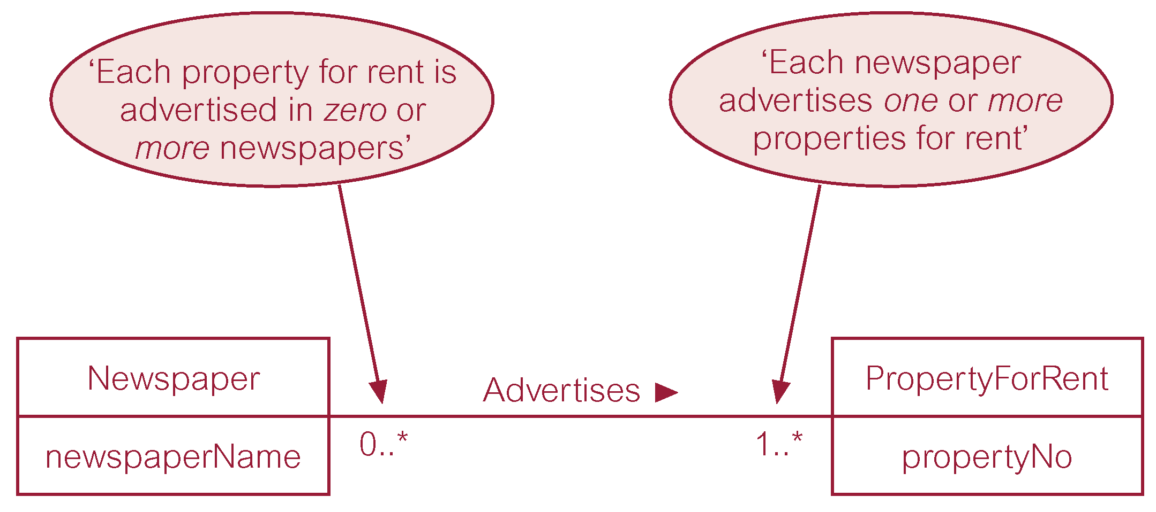
Multiplicity of Newspaper Advertises PropertyForRent (*:*) relationship
© Pearson Education Limited 1995, 2005

Slide 35
Structural Constraints
Multiplicity for Complex Relationships
  Number (or range) of possible occurrences of an entity type in an n-ary relationship when other (n-1) values are fixed.
© Pearson Education Limited 1995, 2005

Slide 36
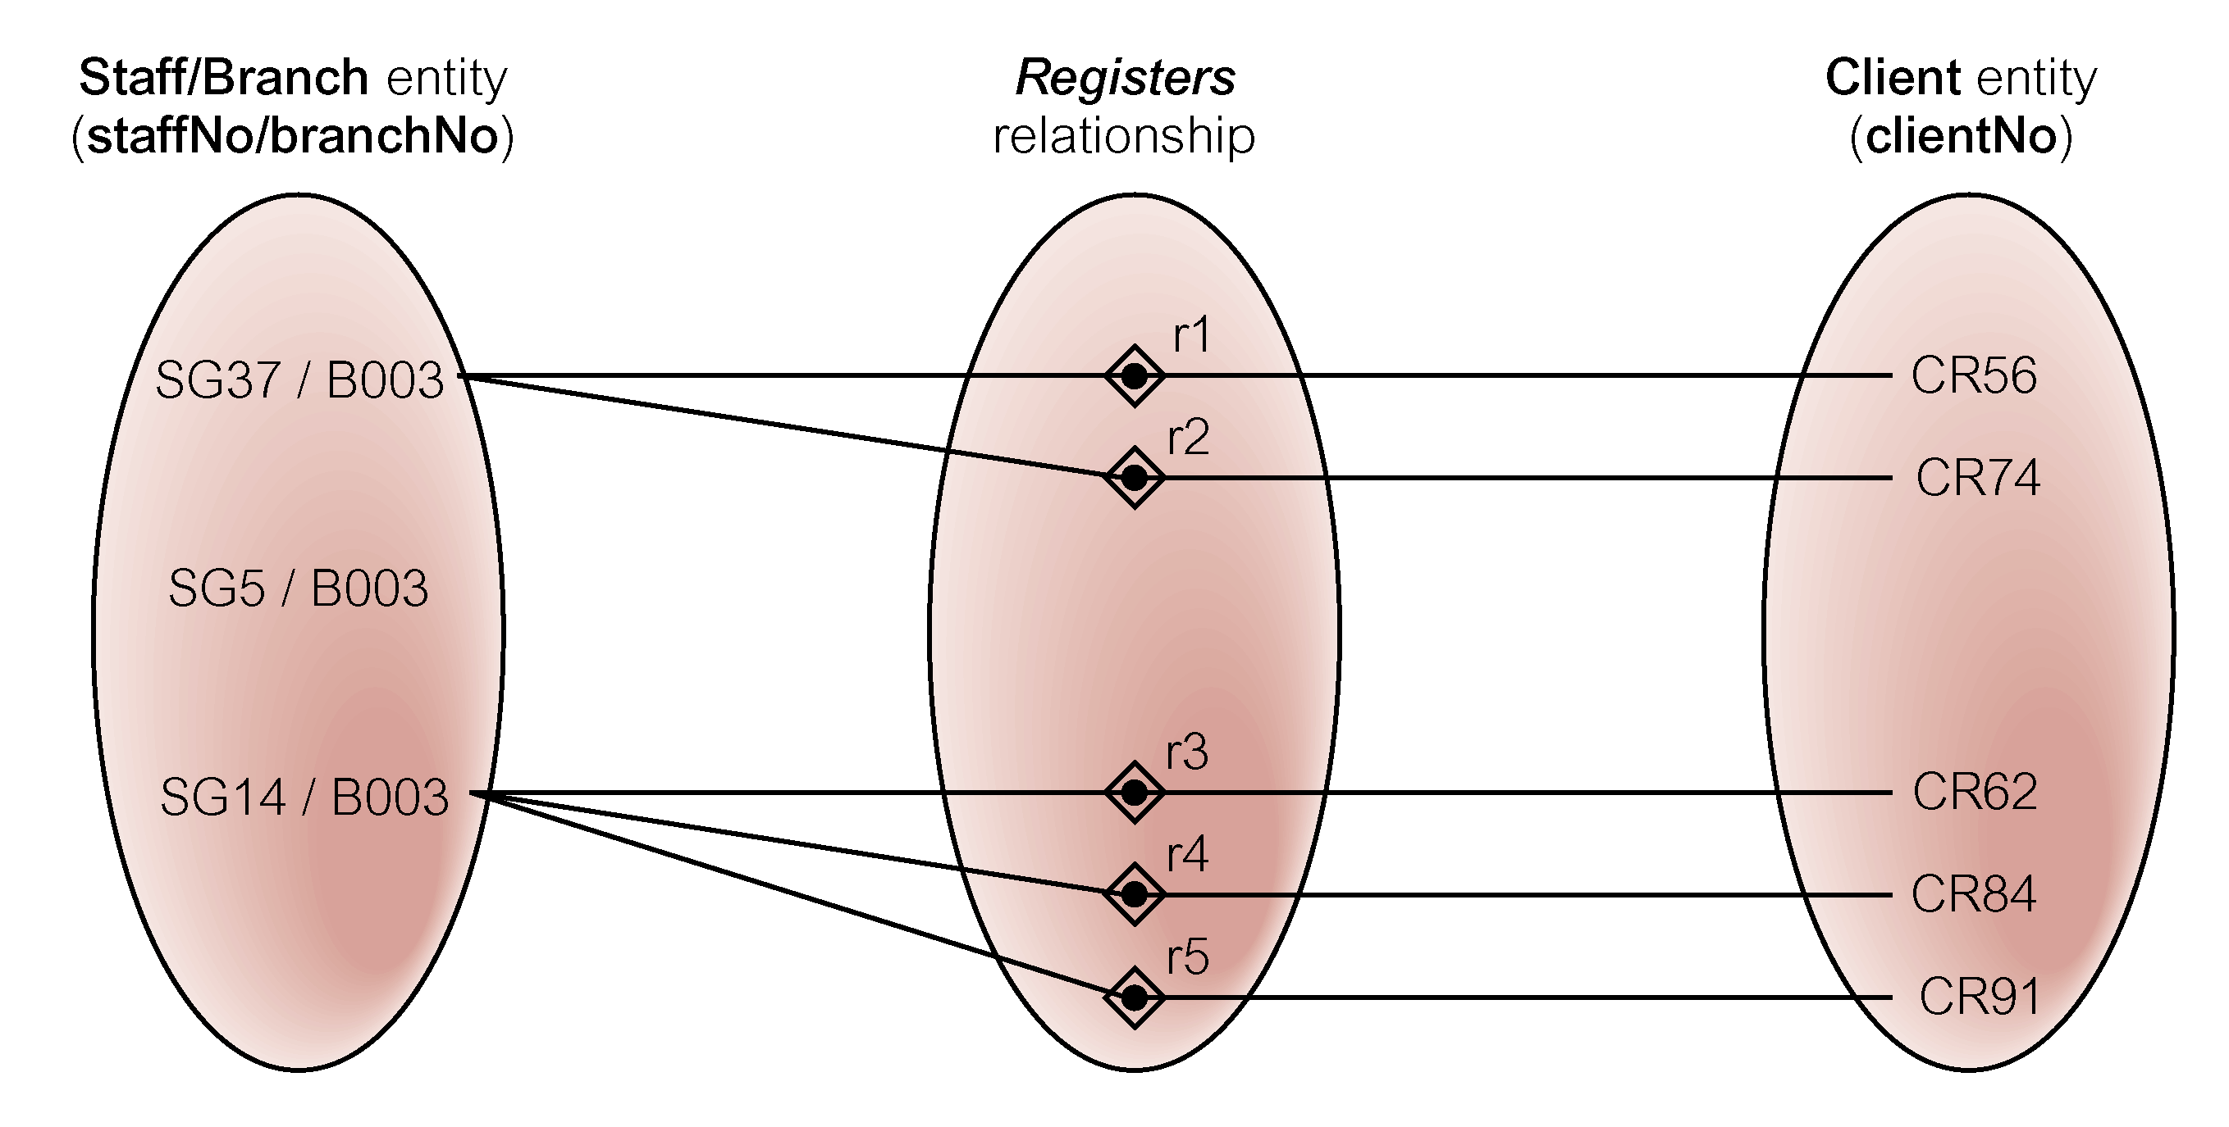
Semantic net of ternary Registers relationship with values for Staff and Branch entities fixed
© Pearson Education Limited 1995, 2005

Slide 37
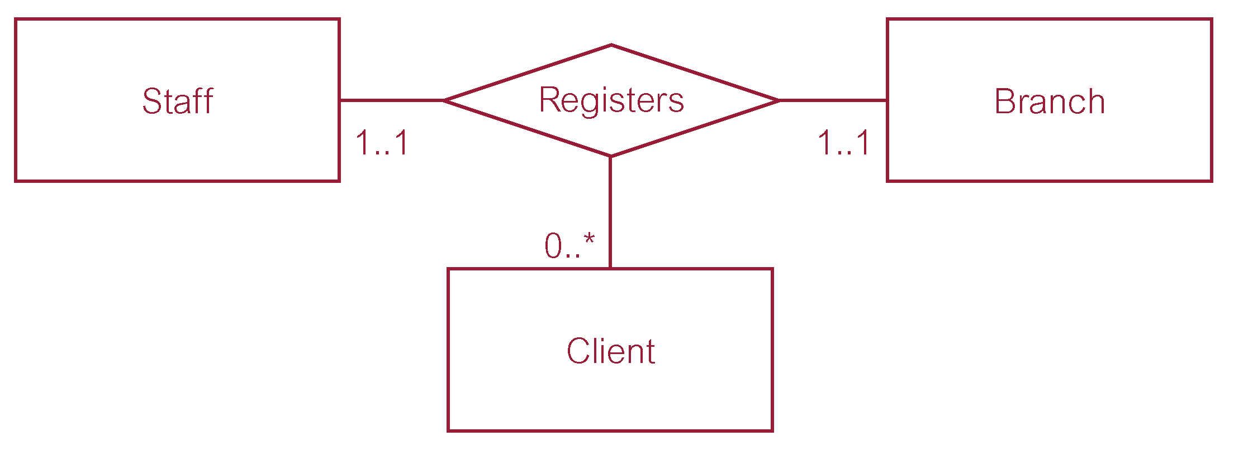
Multiplicity of ternary Registers relationship
© Pearson Education Limited 1995, 2005

Slide 38
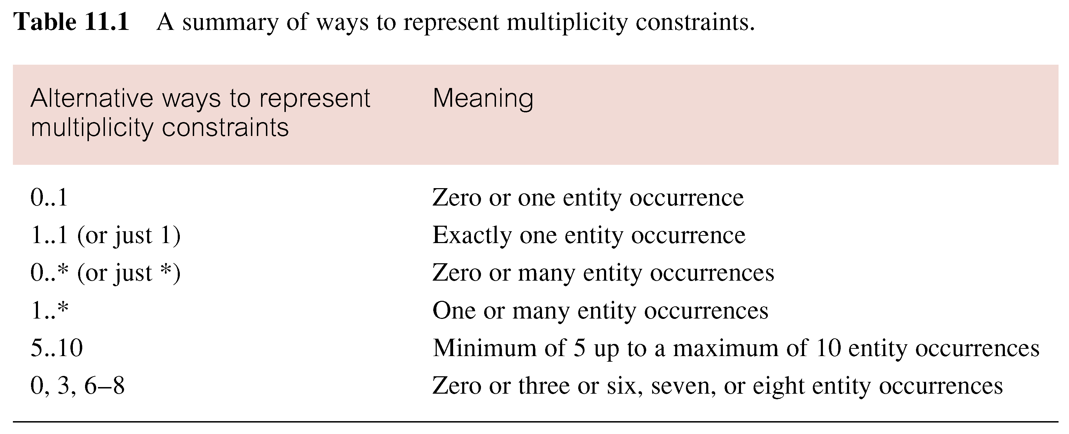
Summary of multiplicity constraints
© Pearson Education Limited 1995, 2005

Slide 39
Structural Constraints
Multiplicity is made up of two types of restrictions on relationships: cardinality and participation.
© Pearson Education Limited 1995, 2005

Slide 40
Structural Constraints
Cardinality
  Describes maximum number of possible relationship occurrences for an entity participating in a given relationship type.
Participation
  Determines whether all or only some entity occurrences participate in a relationship.
© Pearson Education Limited 1995, 2005

Slide 41
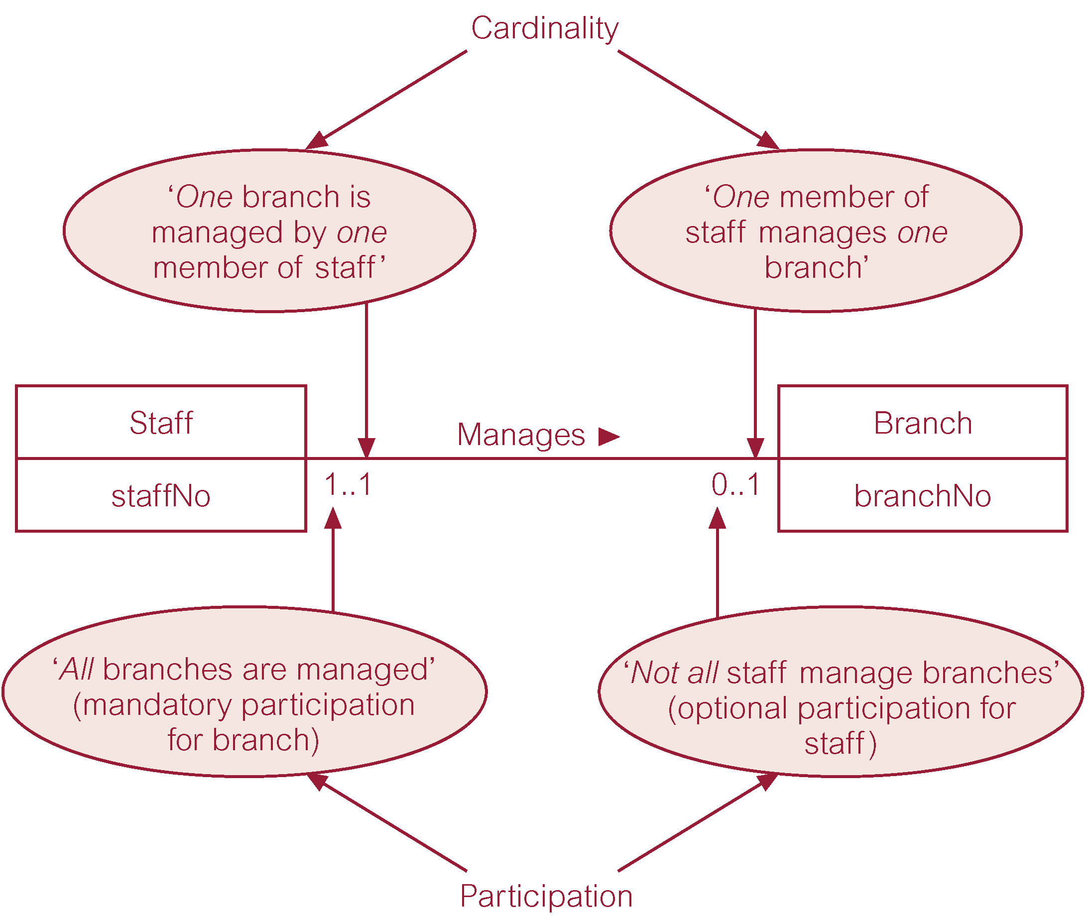
Multiplicity as cardinality and participation constraints
© Pearson Education Limited 1995, 2005

Slide 42
Problems with ER Models
Problems may arise when designing a conceptual data model called connection traps.
Often due to a misinterpretation of the meaning of certain relationships.
Two main types of connection traps are called fan traps and chasm traps.
© Pearson Education Limited 1995, 2005

Slide 43
Problems with ER Models
Fan Trap
  Where a model represents a relationship between entity types, but pathway between certain entity occurrences is ambiguous.
Chasm Trap
  Where a model suggests the existence of a relationship between entity types, but pathway does not exist between certain entity occurrences.
© Pearson Education Limited 1995, 2005

Slide 44

An Example of a Fan Trap
© Pearson Education Limited 1995, 2005

Slide 45
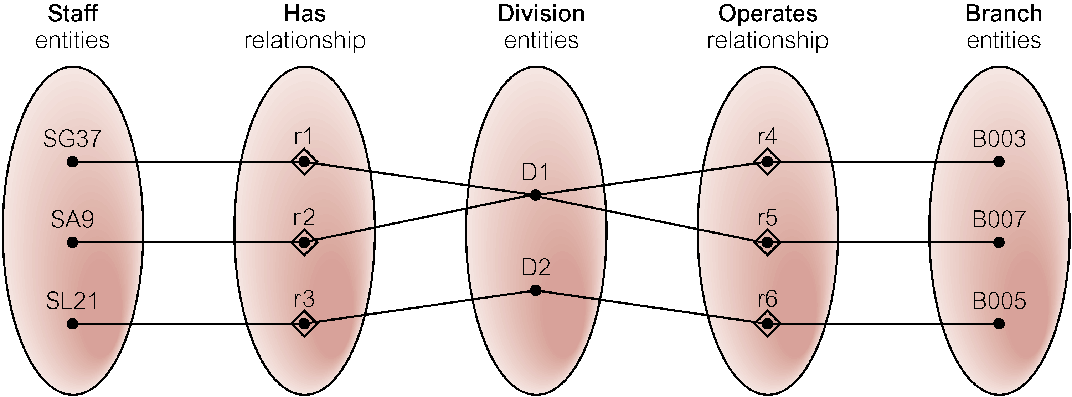
Semantic Net of ER Model with Fan Trap
At which branch office does staff number SG37 work?
© Pearson Education Limited 1995, 2005

Slide 46
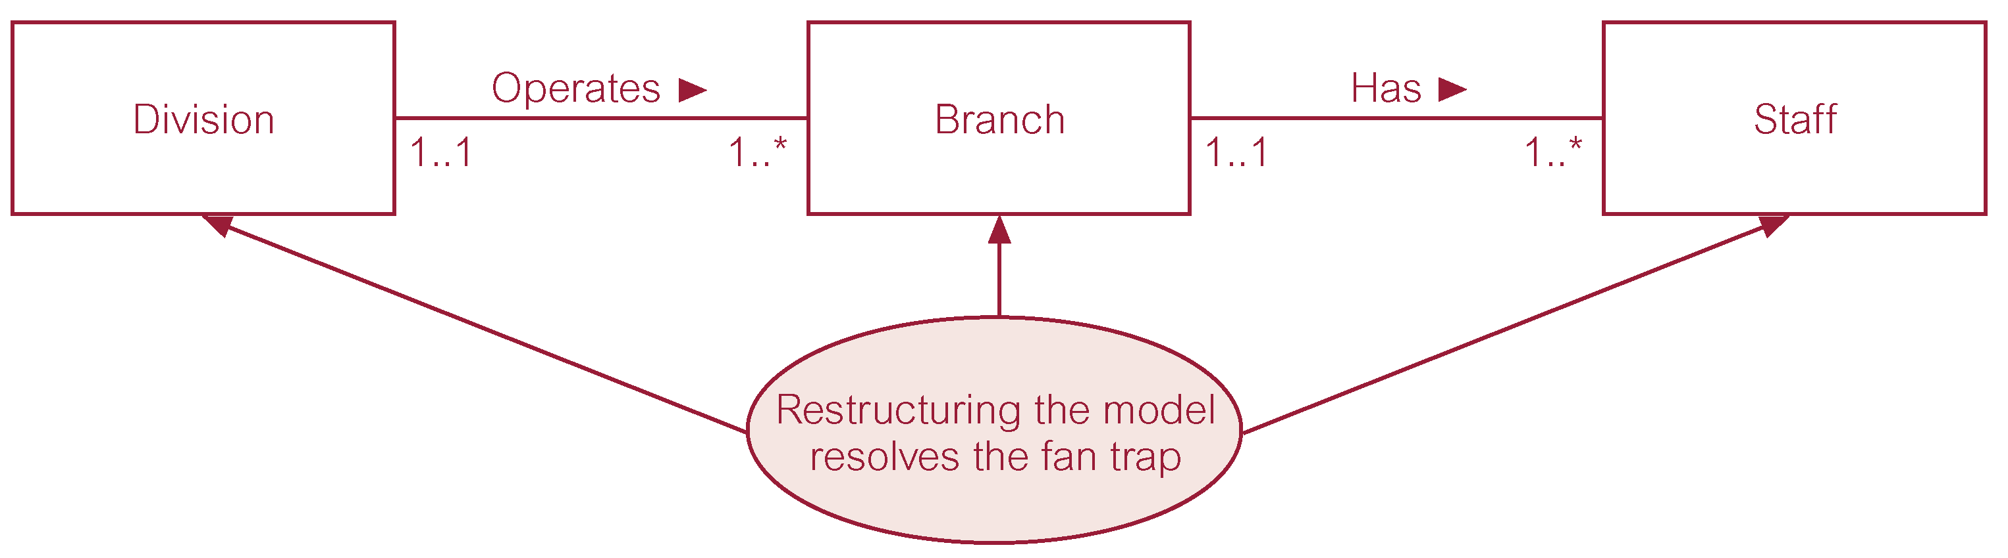
Restructuring ER model to remove Fan Trap
© Pearson Education Limited 1995, 2005

Slide 47
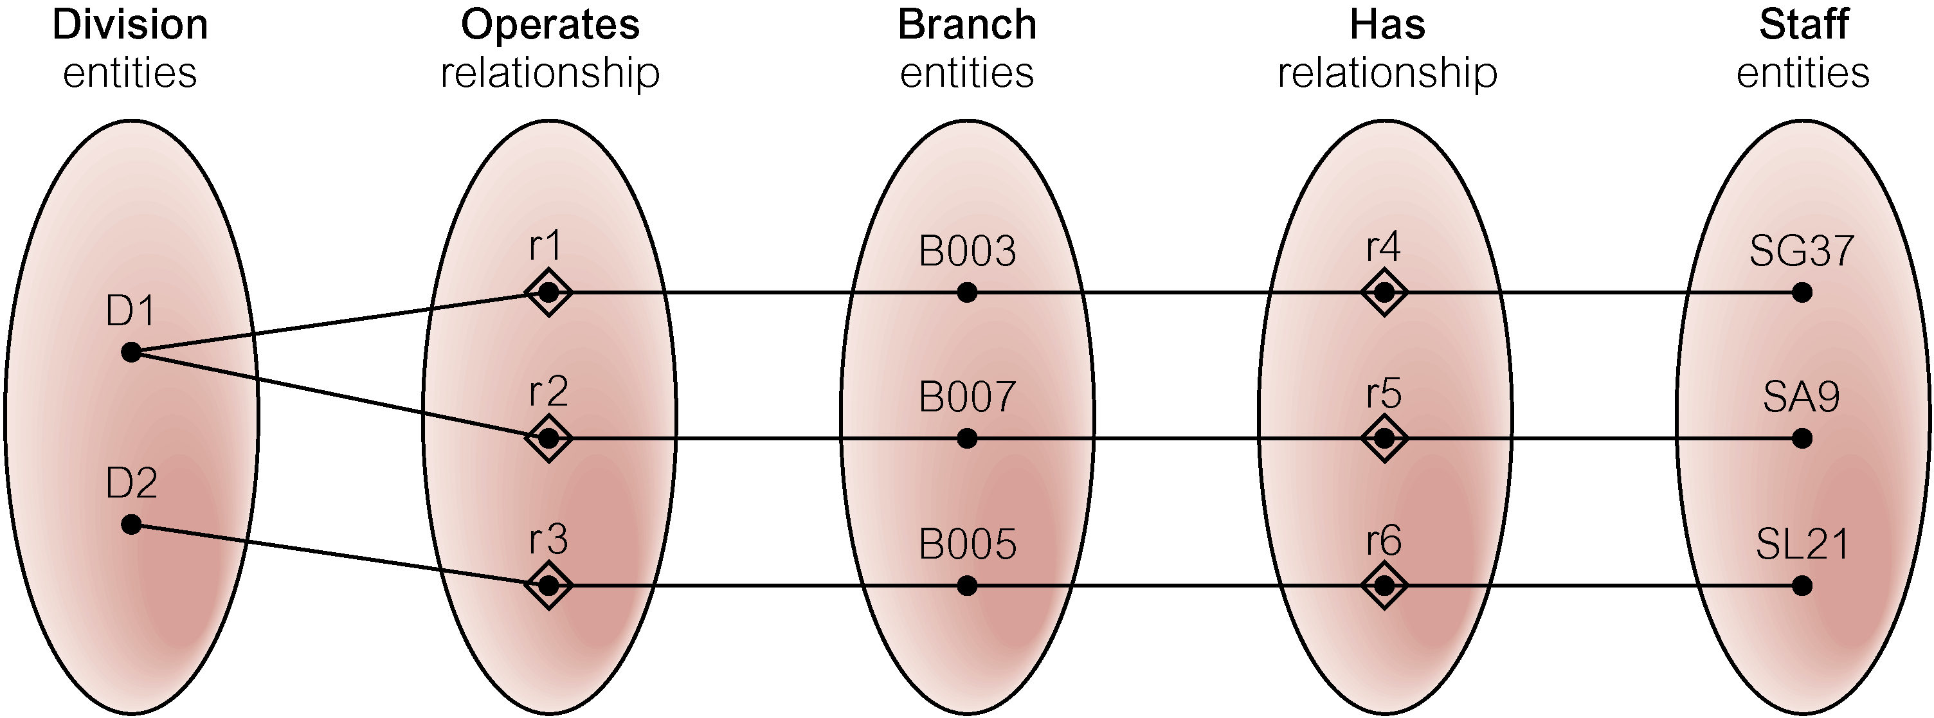
Semantic Net of Restructured ER Model with Fan Trap Removed
SG37 works at branch B003.
© Pearson Education Limited 1995, 2005

Slide 48

An Example of a Chasm Trap
© Pearson Education Limited 1995, 2005

Slide 49
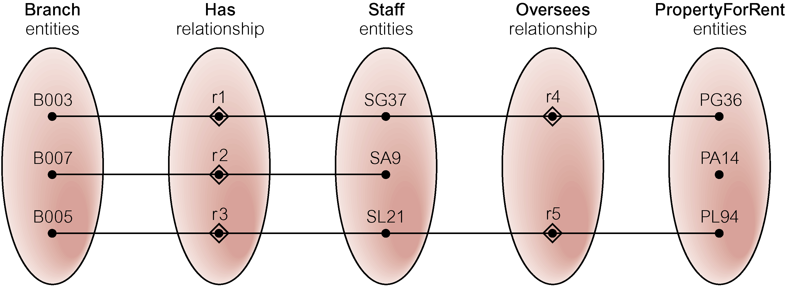
Semantic Net of ER Model with Chasm Trap
At which branch office is property PA14 available?
© Pearson Education Limited 1995, 2005

Slide 50
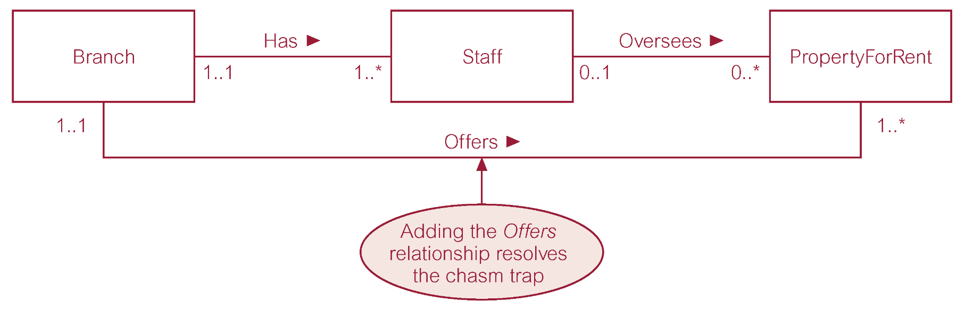
ER Model restructured to remove Chasm Trap
© Pearson Education Limited 1995, 2005

Slide 51
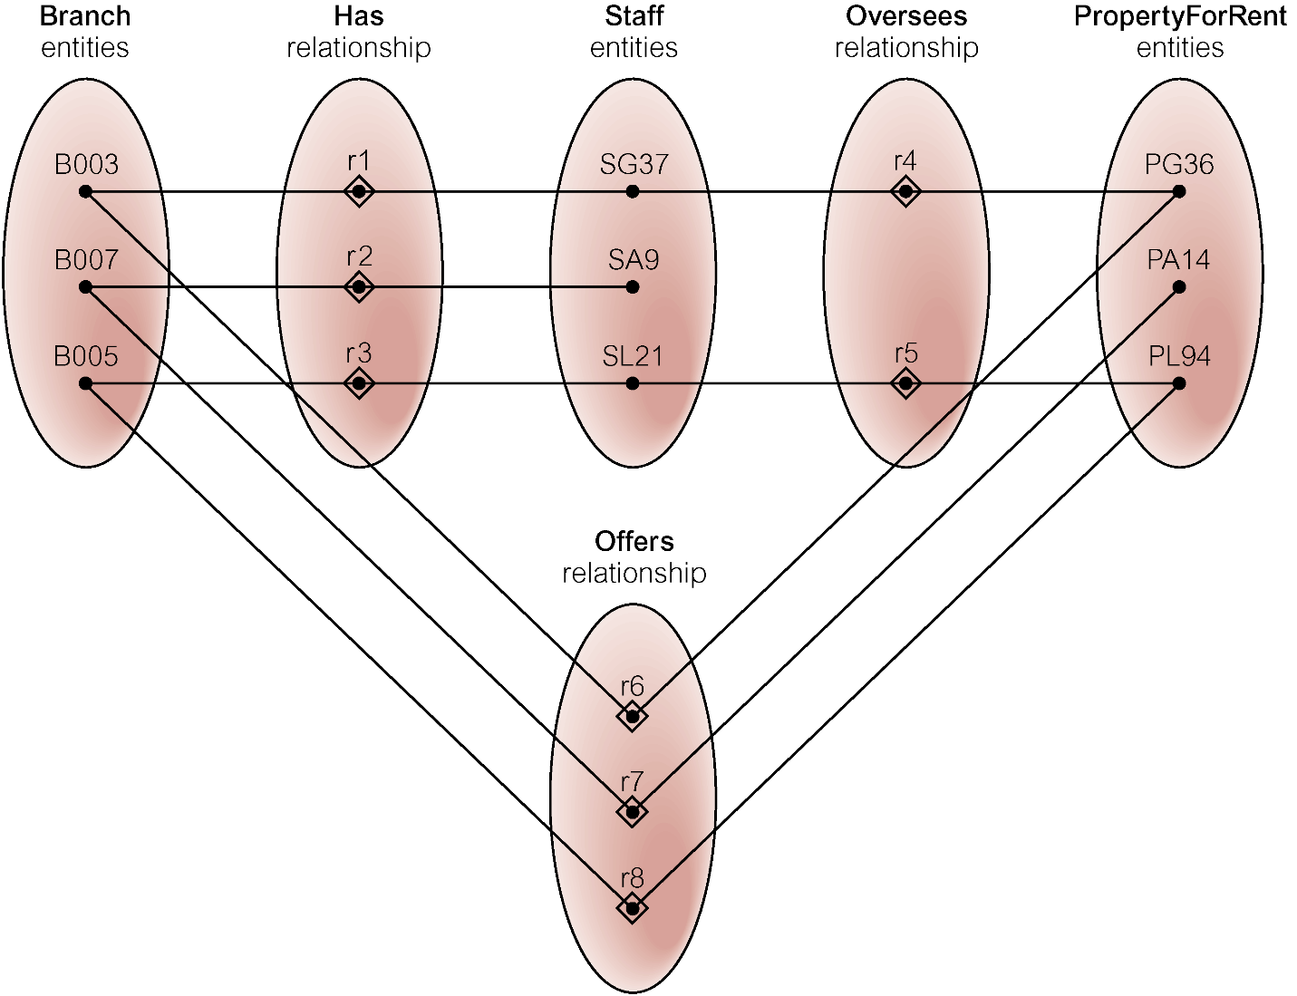
Semantic Net of Restructured ER Model with Chasm Trap Removed
© Pearson Education Limited 1995, 2005

